Slide 1
EE 66 Lab
Image Deconvolution
Welcome! We will begin at Berkeley Time.

Slide 2
Today’s Agenda
Introduction to image reconstruction
PSFs and convolution
Convolution matrices, SVD, and conditioning
Regularization and Fourier reconstruction
Lab workflow and final challenge

Slide 3
Semester Outline
Shazam
Acoustic Positioning
Voice
Recognition
Image Deconv
Medical Imaging

Slide 4
Today’s Lab: Image Deconvolution
●
Why do cameras produce blurry images?
●
How does convolution model an imaging system?
●
Why is “undoing” blur harder than applying it?
●
How can we reconstruct an image without amplifying noise?
Goal: understand the model before you start coding.

Slide 5
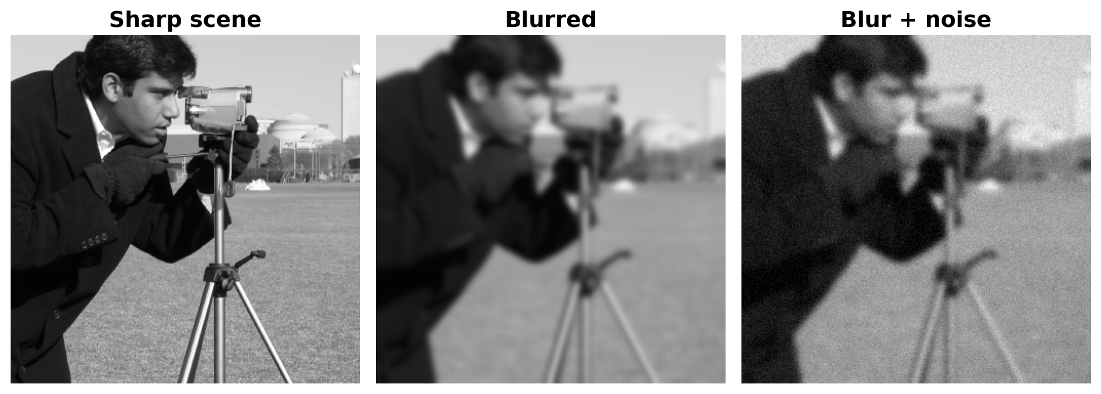
A Camera Is a Measurement System
The sensor sees a blurred and noisy measurement — not the original scene.

Slide 6
Poll Time!
Which effects can you completely reverse?
●
A. Motion blur
●
B. Defocus blur
●
C. Sensor noise
●
D. It depends on what information survived

Slide 7
Poll Answer
Which effects can you completely reverse?
●
A. Motion blur
●
B. Defocus blur
●
C. Sensor noise
●
D. It depends on what information survived
A blur can only be reversed where information survived the measurement.

Slide 8
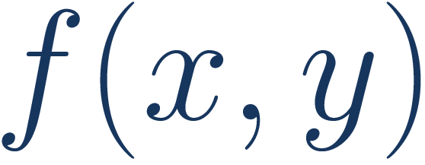
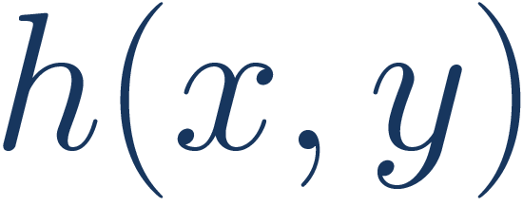
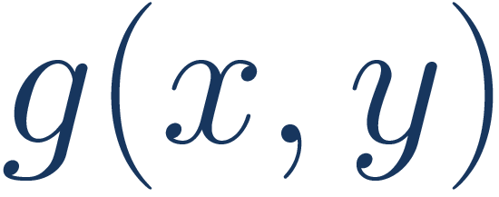
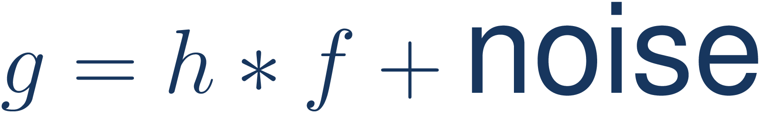
Model: Sharp Image → Camera → Measurement
*
→
sharp scene
blur / PSF
measured image
The asterisk means convolution, not ordinary multiplication.

Slide 9
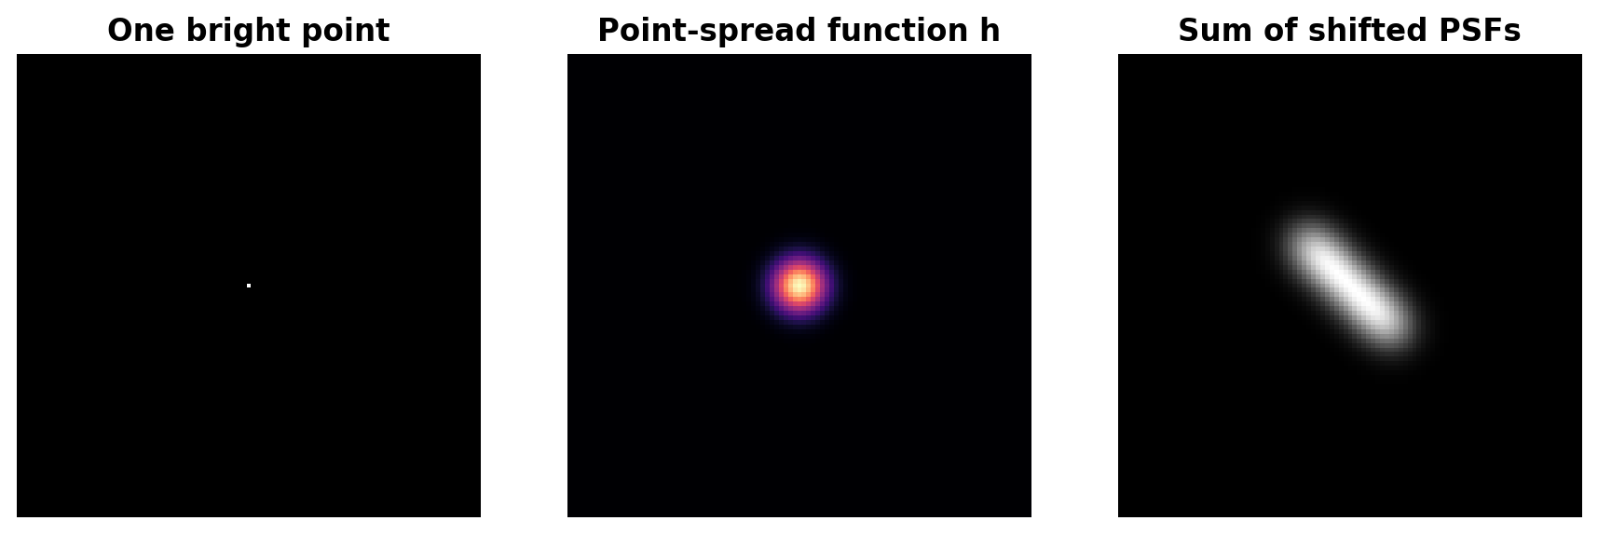
Point-Spread Function (PSF)
●
The PSF h is the camera’s response to ONE point.
●
A whole image is built from shifted, scaled copies of h.

Slide 10
From Physical Blur to Convolution
Continuous 2D model
Discrete pixel model
Same idea: every input pixel contributes a shifted PSF.

Slide 11
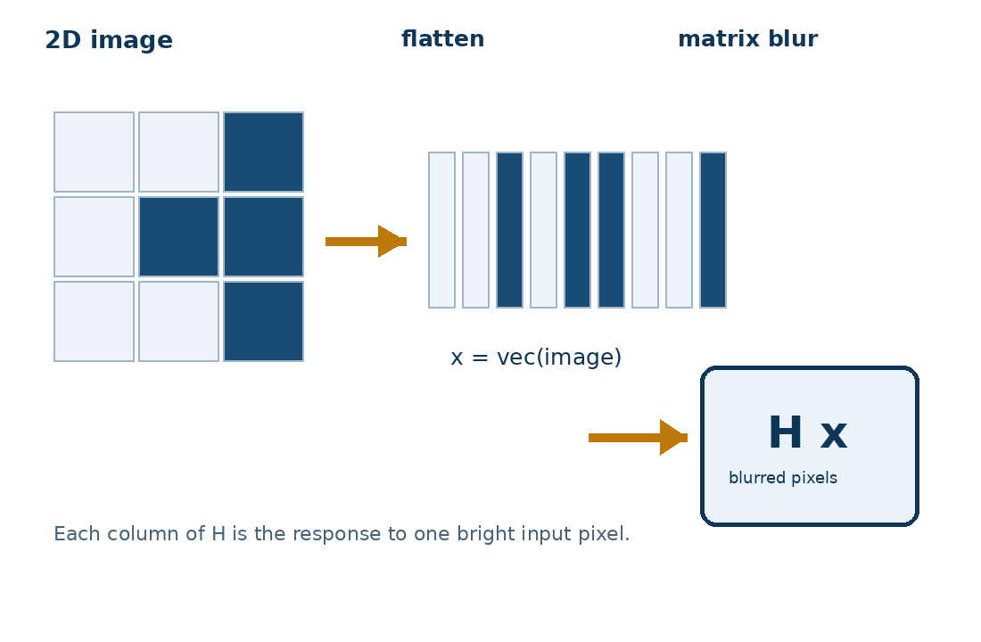
Convolution Is a Linear Operator
●
x: flattened sharp image
●
y: flattened blurred image
●
H: matrix built from the point-spread function
●
Each column of H = blurred response to one basis pixel
Columns are impulse responses; rows collect contributions to one output pixel. Notebook: construct H for a 5 × 5 image.

Slide 12
Poll Time! Build the Convolution Matrix
If the input is a single bright pixel, what should one column of H contain?
●
A. The original image
●
B. An appropriately shifted PSF
●
C. The singular values of H
●
D. Random noise
Connect the column to the output of a basis-image impulse.

Slide 13
Poll Answer: Build the Convolution Matrix
If the input is a single bright pixel, what should one column of H contain?
●
A. The original image
●
B. An appropriately shifted PSF
●
C. The singular values of H
●
D. Random noise
Column j is the blurred output of an impulse placed at input pixel j.

Slide 14
Why Inversion Is Difficult
Near-zero gain means huge inverse gain: 1 / 0.001 = 1000× amplification of both signal and noise.

Slide 15

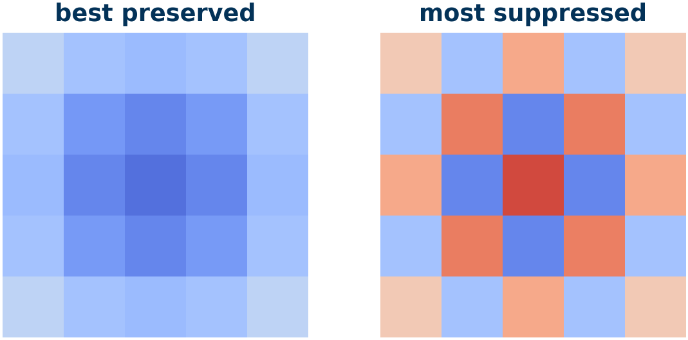
Ill-Conditioning: Why Inversion Is Unstable
• σᵢ is the gain for one input pattern.
• Small σᵢ: the camera nearly erases that pattern.
• κ(H) = σₘₐₓ / σₘᵢₙ compares strongest and weakest gains.
• Large κ means ill-conditioned and noise-sensitive.
Inversion divides by σᵢ. If σᵢ is near zero, tiny errors become huge.

Slide 16
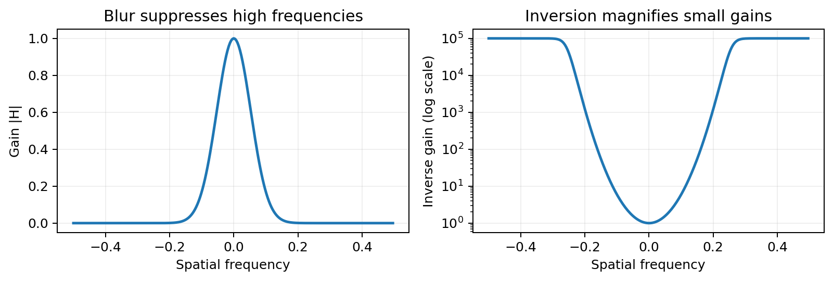
Frequency View: The Same Instability
The OTF H is the Fourier transform of the PSF. Where |H| ≈ 0, direct inverse gain 1/|H| blows up.

Slide 17
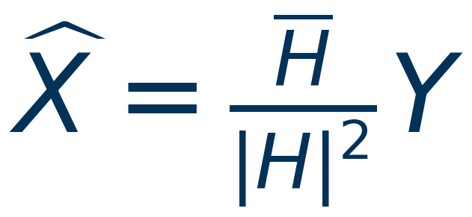
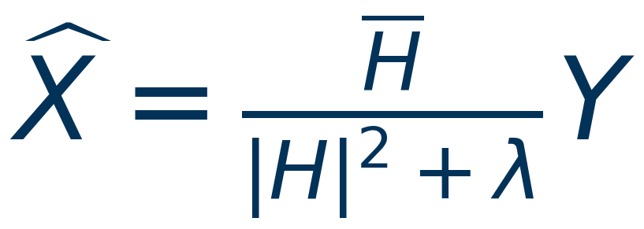
Why Regularization Prevents the Blow-Up
Direct inverse
Regularized inverse
Tiny |H| ⇒ near-zero denominator ⇒ enormous noise gain.
λ keeps the denominator away from zero, so the gain stays bounded.
Regularization limits noise amplification; it cannot recreate erased information.

Slide 18
Tikhonov Regularization
• Data fit: blurring the candidate should reproduce the measurement.
• Penalty: avoid extreme pixel values used only to chase noise.
• λ is a trust knob: small λ is sharper/noisier; large λ is safer/blurrier.
This is ridge regression applied to the image-reconstruction problem.

Slide 19

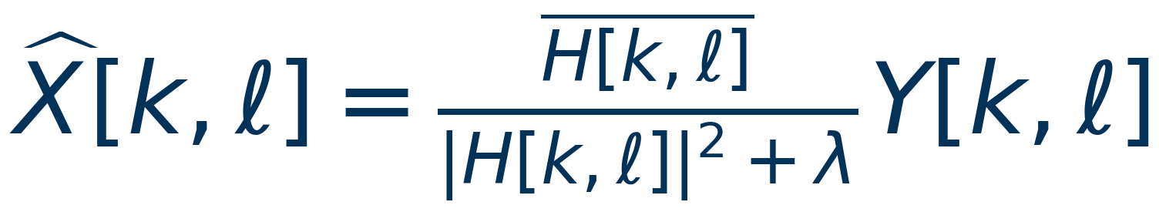
Ridge Regression → Fourier Deconvolution
Matrix-domain ridge solution
Fourier transform diagonalizes convolution ↓
One scalar update per spatial frequency
The same ridge solution, expressed one frequency at a time. H[k,ℓ] is the OTF.

Slide 20
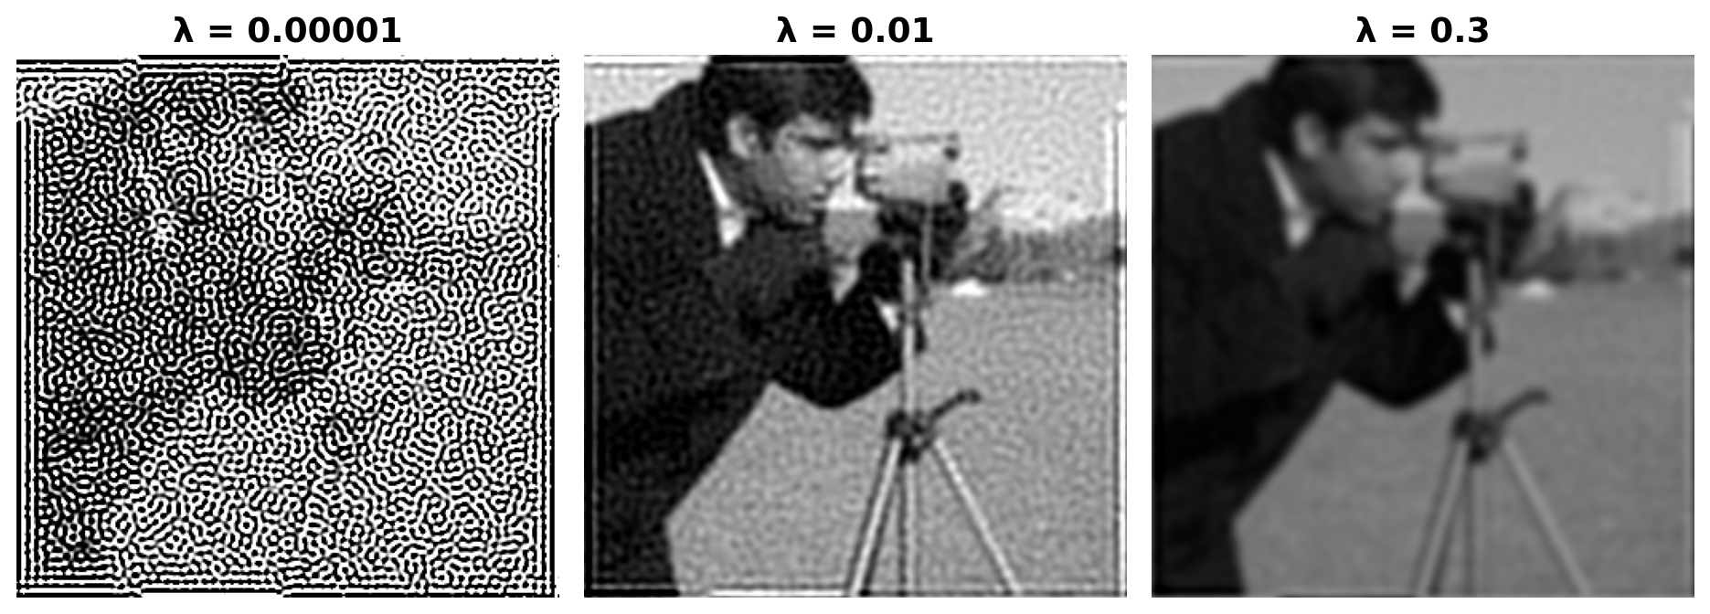
See the Regularization Tradeoff
Too little: noise + ringing
Useful compromise
Too much: detail suppressed

Slide 21
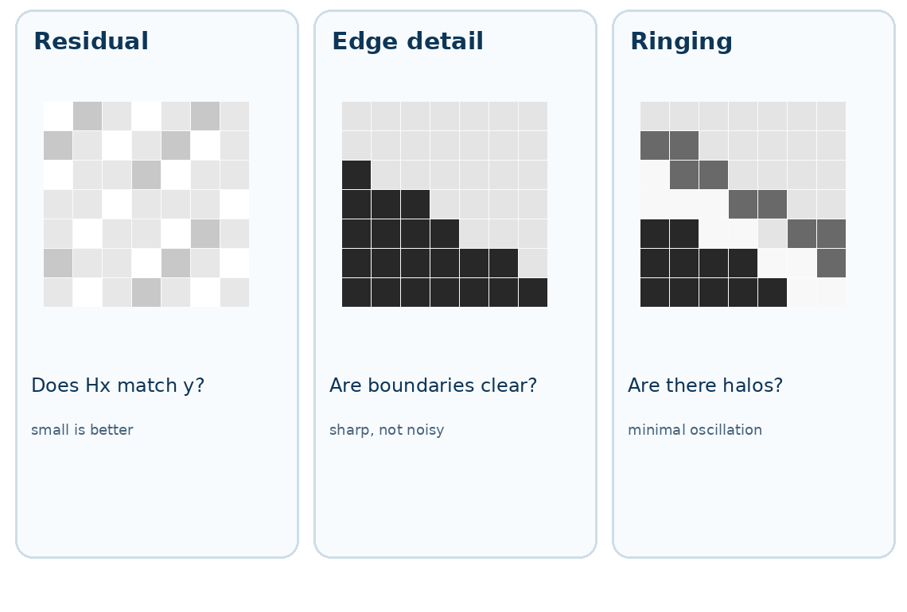
Choosing λ Without Ground Truth
●
Sweep candidate λ values.
●
Compare residual, roughness, ringing, and edge detail.
●
Residual checks data fit; roughness flags oscillation.
●
Caution: real edges are rough too, so no single score is perfect.

Slide 22
Lab Workflow & Final Challenge
●
1. Explore blur, PSFs, and discrete convolution.
●
2. Build H; inspect singular values and conditioning.
●
3. See why direct inverse filtering fails.
●
4. Implement regularized reconstruction and tune λ.
●
5. Test blur parameters and reveal a hidden message. Enter angle, λ as 10, 1e-3.

Slide 23
Final Challenge: Motion-Blur Angle Convention
−30°
0°
+30°
clockwise
horizontal
counterclockwise
Angles are measured from horizontal: + is counterclockwise and − is clockwise.
The line has no arrow, so θ and θ + 180° are equivalent. Enter angle, λ; for example: 10, 1e-3.

Slide 24
Checking-off Today
Pass all autograder checks and recover the personalized hidden message (we will ask about it in the checkoff!)
Follow the directions linked at bottom of the lab
  Fill out Google form.
  Station number: Sit at a lab computer and enter the number ## on the monitor (c111-##)
During checkoff:
  You will be asked a series of conceptual questions. Make sure you fully understand what is going on.
  If you want to add songs to our playlist: tinyurl.com/66-playlist

Slide 25

Feedback Time
https://tinyurl.com/bdf3ya92

